Slide 1

PUSL2019 Information Management & Retrieval
Lesson 1 Introduction to Databases
S.Naji
naji@nsbm.lk
1

Slide 2


Lesson Outline
What is a Database?
Why do we need a Database?
What is Database Management System (DBMS)?
What are the elements of a database?
What are the Database relationships?
What are defined as PK, FK and Composite PK, Referential Integrity?
2

Slide 3
What is a Database?
A very large collection of logically related data that is
organized to manipulate easily.
Models real-world activities.
Entities (eg: students, courses)
Relationships (eg: Madara is studying PLY B6)
3

Slide 4




Physical Examples?
4

Slide 5
Physical DB
Student Attendance Registry
Dictionary
Telephone Directory
Book Cupboard in a library
Supermarket
Encyclopedia
5

Slide 6
Database Applications
Banking System
Reservation System
Order Processing System
Library Management System
Payroll Administration System
Logistics Management System
University Management System
6

Slide 7

Why do we need a Database?
7

Slide 8

Manual Data Processing Systems

Slide 9
Drawbacks of Manual Data Processing
High paper work
Lots of errors
Time consuming
Data duplication
Need a large storage space
Difficulty in accessing data
Less security
Difficulty to take backups
Large number of employee involvement

Slide 10
Types of Data Processing Systems
Manual Data Processing Systems
File Based Data Processing Systems
Database Processing Systems

Slide 11
File Based Data Processing Approach
A collection of application programs that perform services for the end-users by managing organization’s operational data on separate computer files.
It is an early attempt to computerize the manual data processing system with a decentralized approach, where each department, with the assistance of Data Processing (DP) staff, stored and controlled its own data.

Slide 12
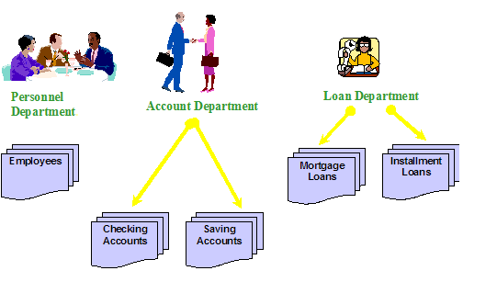
File Based Data Processing

Slide 13
File Based Data Processing
Customer Customer No. Customer Name
Customer Addr. Social Security ID
Invoice
Customer No. Customer Name Part No.
Quantities
Unit Price
Inventory
Part No.
Part Description Unit Price Supplier Quantities Remain Quantities Ordered
Parts
Part No.
Part Description Supplier Quantities Ordered Customer Name Unit Price

Slide 14
Limitations of File Based Processing
Data redundancy (duplication)
Data inconsistency (mismatches)
Incompatible ﬁle format
Difficulty in accessing data
Separation and isolation of data
Data integrity problems
Problems with concurrent access by multiple users

Slide 15
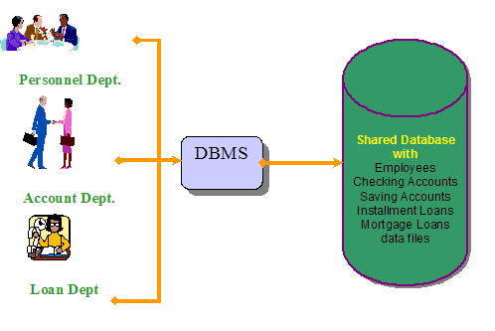
Database Processing Approach
All applications interact with the same data in a centralized database.

Slide 16
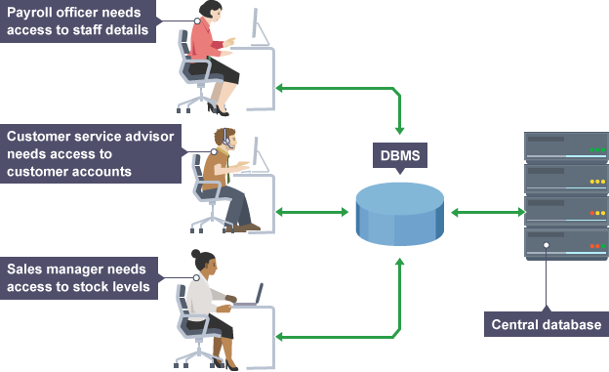
Database Processing Approach

Slide 17
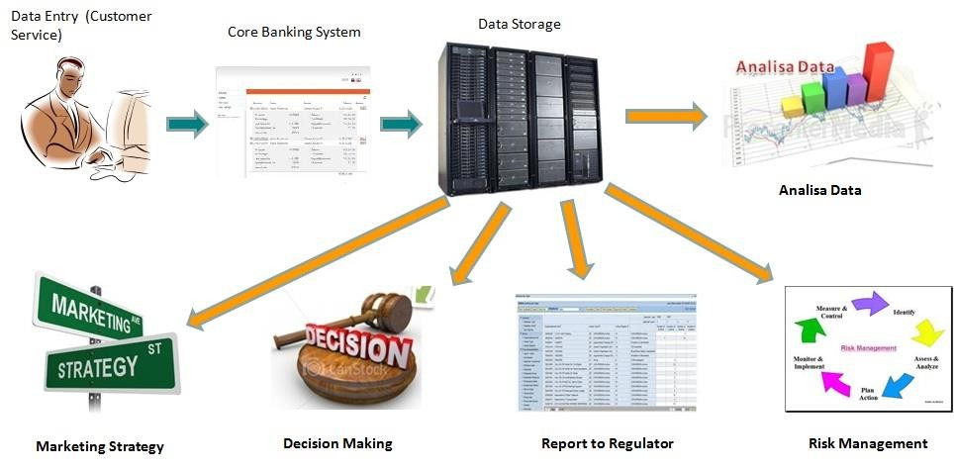
Database Processing System

Slide 18
Advantages of Database Approach
Program data independency
Minimal data redundancy
Improved data consistency
Improved data sharing
Increased productivity of application development
Enforcement of application development
Improved data quality
Improved data accessibility and responsiveness
Reduced program maintenance

Slide 19
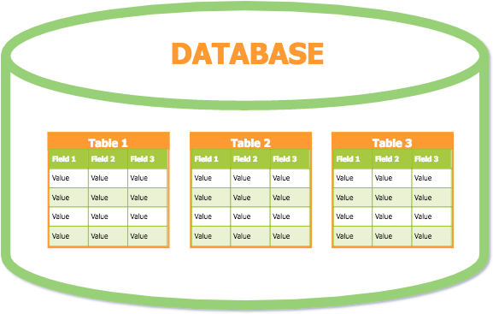
Database Management System (DBMS)
A software package designed to create databases and manipulate data.
Contains a collection of interrelated data and a set of programs to access the data.
Examples for DBMS:
Microsoft Access
My SQL
Microsoft SQL Server
Oracle

Slide 20
Elements of a Database
Entities
The things we are going to save information about.
e.g: Customer, Supplier, Order
Attributes
A single item of information to be saved about that entity
Eg: Customer Id, Name, Address, Contact no, etc

Slide 21
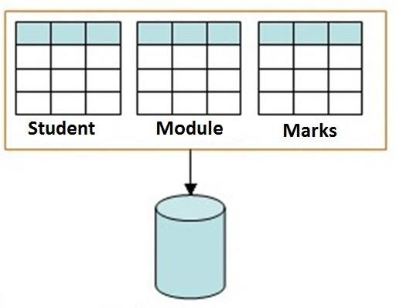
Elements of a Database
Relation
A single file/table
Contains data about an entity

Slide 22
Elements of a Relation
Field
A column of a relation
Characteristics about the entity
Record
A row of the relation
Includes the information about a particular entity

Slide 23

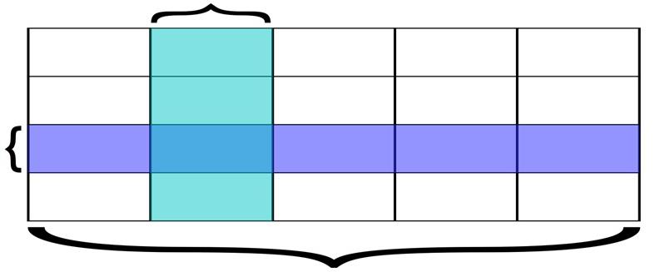

Elements of a Relation
Record

Slide 24
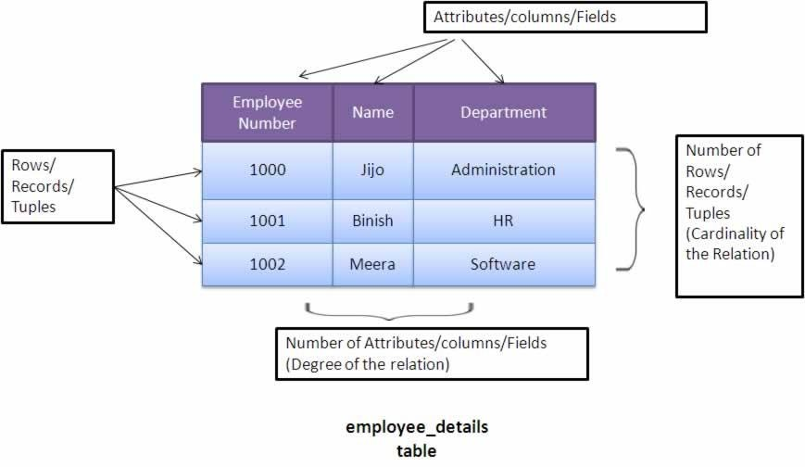
Elements of a Relation

Slide 25
Database Relationships
Tells the number of records in one table which are linked to the number of occurrences in another.
One to one (1:1)
One to many (1:m)
Many to many (m:n)

Slide 26

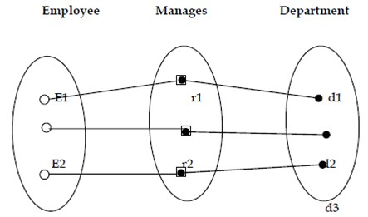
One-to-one (1:1)
One occurrence of an entity relates to only one occurrence in another entity.

Slide 27
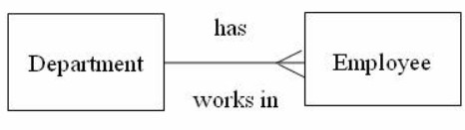
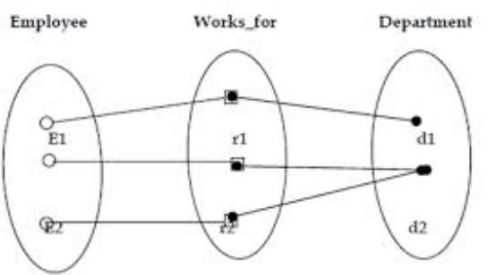
One-to-Many (1:M)
One occurrence in an entity relates to many occurrences in another entity.

Slide 28
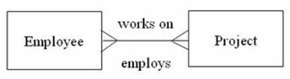
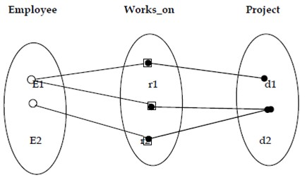
Many-to-Many (M:N)
Many occurrences in an entity relate to many occurrences in another entity.

Slide 29
Primary Key (PK)
A field which identify each record in the relation uniquely.
Unique for each record.
A table must have one primary key.
PK
Student_ID | Name | Gender
1 | Ann | F
2 | Peter | M
3 | Tom | M
4 | Rose | F
5 | Peter | M

Slide 30
Foreign Key (FK)
A field in one relation which refers to a field in another relation.
Always refers to a primary key of the other table.
PK
FK
PK
Student_ID | Name | Course
1 | Ann | SE
2 | Peter | CN
3 | Tom | SE
4 | Rose | CS
5 | Peter | CS
CCode | Course Name
SE | Software Engineering
CS | Computer Science
CN | Computer Networks

Slide 31
Composite PK
PK can be a combination of two or more fields when there is no unique field in the particular relation.
The combination of two or more fields will help to identify a record uniquely.
PK
Student_ID |  |  | Module |  | Marks
1 |  |  | ISAD253SL |  | 54
1 |  |  | ISAD254SL |  | 61
2 |  |  | ISAD253SL |  | 69
2 |  |  | ISAD254SL |  | 48
3 |  |  | ISAD253SL |  | 28
3 |  |  | ISAD254SL |  | 34

Slide 32
Referential Integrity
A relational database concept, which states that table relationships must always be consistent.
Any foreign key field must have only the value which are in the primary key field that is referenced by the foreign key.
Student_ID | Name | Course
1 | Ann | C1
2 | Peter | C2
3 | Tom | C4
4 | Rose | C3
5 | Peter | C2
CCode | Course Name
C1 | Software Engineering
C2 | Computer Science
C3 | Computer Networks
Violates referential integrity.

Slide 33
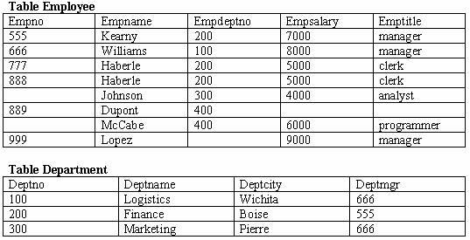
Referential Integrity
This violates the referential integrity.

Slide 34
Lesson Summary
What is a Database?
Why do we need a Database?
What is Database Management System (DBMS)?
What are the elements of a database?
What are the Database relationships?
What are defined as PK, FK and Composite PK, Referential Integrity?

Slide 35
Thank You
35

